Slide 1



SEA HS&E Committee
Webinar Update
1st November 2022
The power of membership www.sea.org.uk

Slide 2
Disclaimer
The material in this presentation is for informational purposes only and has been prepared by the Surface Engineering Association.
Although we have taken care to ensure that the information is current and accurate, it does not constitute legal advice and we are not liable for any omissions or misunderstandings.
The power of membership www.sea.org.uk

Slide 3
Competition Law
During the webinar participants should not discuss any of the following items:
1 - Price or price elements (including discounts, rebates, surcharges, allowances, concessions, price mark-ups, and the like).
2 - Terms and conditions on which you supply services to your customers.
3 - Information relating to individual customers, suppliers, or competitors.
4 - Allocation of services, customers, markets, territories, or sales.
5 - Bids, bidding terms, tactics, strategies or practices.
6 - Refusals to purchase from, or modification of purchase arrangements with, suppliers.
7 - Profits, margins and costs.
8 - Strategic plans, business plans, intentions, promotional activities and marketing strategies or investment plans.
9 - Any other confidential or competitively sensitive information.
The power of membership www.sea.org.uk

Slide 4
Overview
REACH
Silver Update
Cobalt Update
Net Zero
HSE Issues
Environment Issues
Any sector / Institution Reports
The power of membership www.sea.org.uk

Slide 5
UK REACH – SEA Consortium
3 applications for authorisation submitted before 30th June deadline
35 companies in total
Applications fees to HSE total £92,097
Value of chromium trioxide used £46,000 per annum
Dealing with queries from HSE REACH Team
Still most burdensome legislation for SMEs
The power of membership www.sea.org.uk

Slide 6
UK REACH – SEA Consortium
Working on applications to be submitted early 2023
Hard Chrome Plating
Passivating & Anodising
Formulation
Revised data requirements following HSE REACH team response
to first batch of applications
HSE have 10 months in which to review applications and form
their opinion, before sending to DEFRA for final decision
The power of membership www.sea.org.uk

Slide 7
UK REACH
UK REACH RISEP members public profiles
UK REACH requires HSE (as the agency for UK REACH) to take relevant scientific knowledge and advice into account when fulfilling its obligations under the legislation.
This can be from one or more suitably qualified or experienced persons who are independent of the Agency.
To meet this obligation HSE has formed the REACH Independent Scientific Expert Pool (RISEP).
RISEP provides advice on aspects of the risk of chemicals, as well as socio-economic matters, for the purpose of the Agency’s scientific opinions and other aspects of UK REACH as necessary.
To comply with Article 88 of the REACH regulation, HSE is obliged to make public certain details of the RISEP members.
A list of all members, including their professional qualifications and their declared interests, is now available on the website.
The power of membership www.sea.org.uk

Slide 8
UK REACH – Extra Info from Martin Giles, HSE
HSE has published a statement on independent scientific knowledge and advice and transparency in relation to UK REACH and RISEP on our website here. Section 5.8 of the document addresses how conflicts of interest in RISEP are dealt with. Agency statement on transparency and the use of independent scientific knowledge and advice (ISA) (hse.gov.uk)
As outlined in the relevant section of the document, if an external party believes that there is a conflict of interest within the Challenge Panel, they should provide evidence to support this claim to the RISEP secretariat at RISEP@hse.gov.uk .
The power of membership www.sea.org.uk

Slide 9
UK REACH
Applications for authorisation – chromium trioxide
AFA022-01 – TCL Manufacturing (Perrin & Rowe)
AFA023-01 – Borough Ltd, QPP & Samuel Heath
AFA024-01 – SEA Legacy
AFA025-01 – SEA Sanitaryware & Plumbing
AFA026-01 – SEA Technical
The power of membership www.sea.org.uk

Slide 10
EU REACH
Gave presentation to ECHA Risk Assessment Committee regarding
bio-monitoring
Question mark over trivalent chromium being a suitable alternative
due to boric acid use
Workshop with ECHA & Eurometaux regarding trivalent chromium
Over 300 participants – further developments expected next year
The power of membership www.sea.org.uk

Slide 11
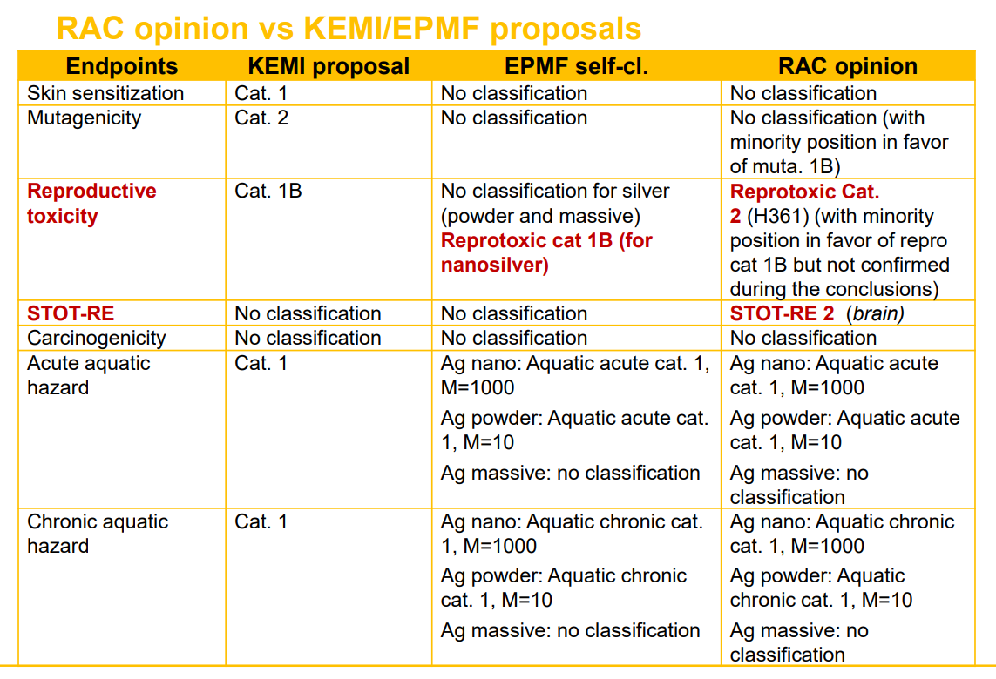
STOT-RE = Specific Target Organ Toxicity – Repeated Exposure
Silver update
The power of membership www.sea.org.uk

Slide 12
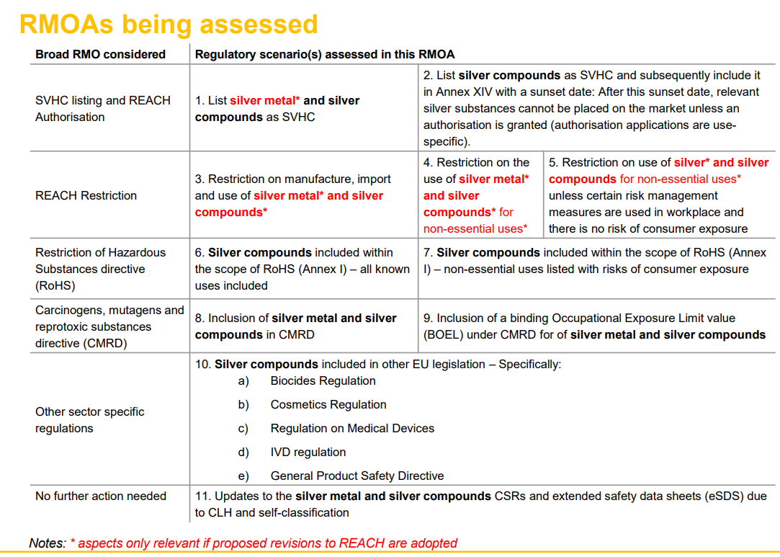
The power of membership www.sea.org.uk

Slide 13
Cobalt update
eftec is supporting the Cobalt Institute (CI) with their industry-wide outreach concerning the introduction of an EU-wide binding Occupational Exposure Limit Value (OELV) for cobalt and cobalt compounds by developing socioeconomic / impact assessment (IA) argumentation to be used during future discussions with the European Commission and Member State Competent Authorities. The analysis will be presented at a workshop in Brussels (end of 2022/beginning of 2023).
Vanessa Viegas, PhD, DABT, ERT
Principal Toxicologist (Human Health)
T. 01483 220 066
18 Jeffries Passage Guildford • GU1 4AP • UK
www.cobaltinstitute.org
The power of membership www.sea.org.uk

Slide 14
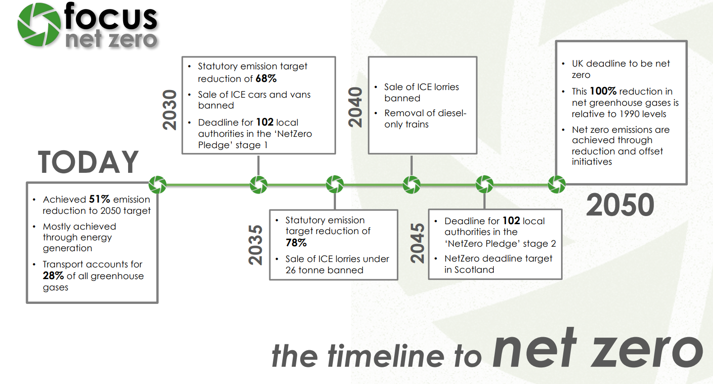
Net Zero
The power of membership www.sea.org.uk

Slide 15
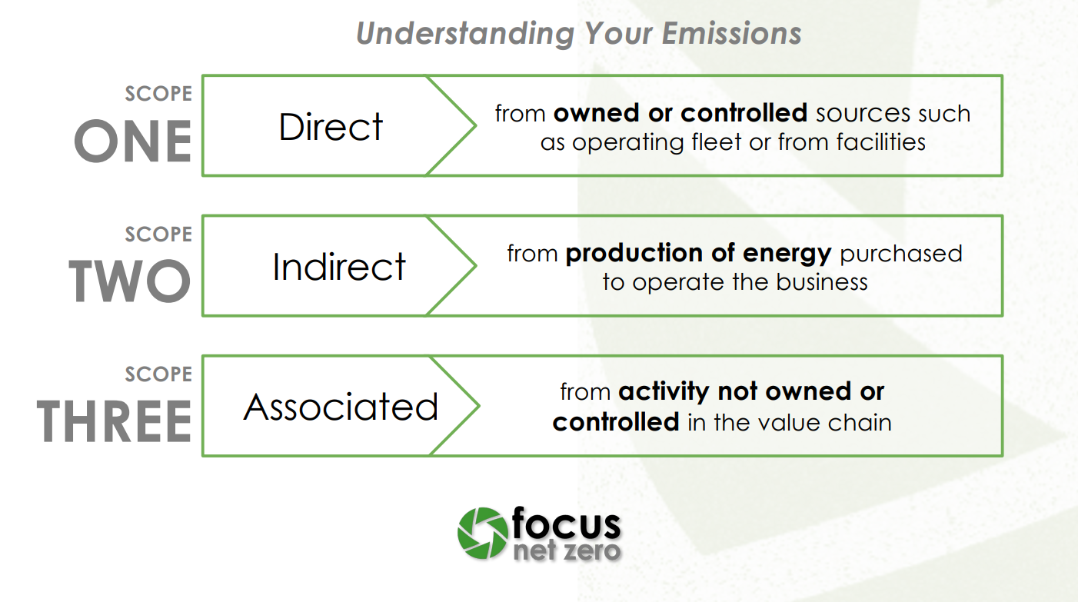
Net Zero
The power of membership www.sea.org.uk

Slide 16
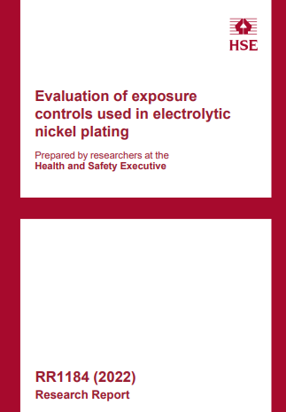
Health & Safety
https://www.hse.gov.uk/research/rrhtm/rr1184.htm
The power of membership www.sea.org.uk

Slide 17
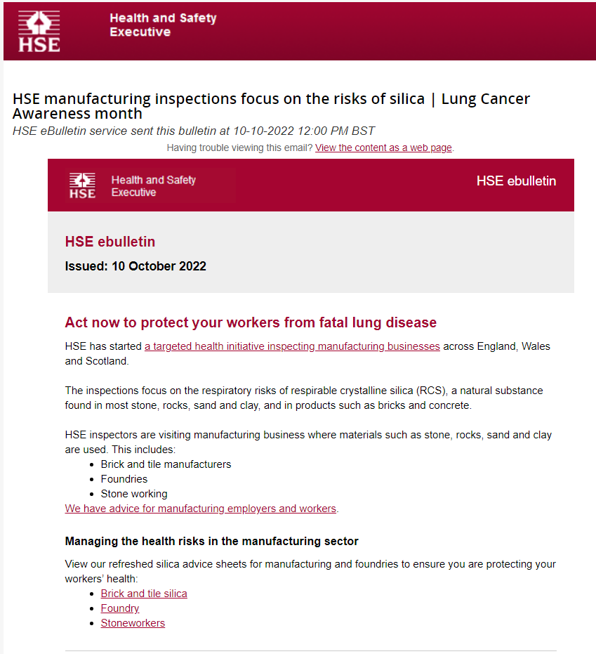
Health & Safety
The power of membership www.sea.org.uk

Slide 18
Environment Issues
SUMMARY BRIEFING FOR EXTERNAL AUDIENCES – ADAPTING TO CLIMATE CHANGE OUR REVISED APPROACH WITHIN EPR PERMITTING Adapting to climate change is a priority and we want to support regulated businesses to maintain compliance and so that they can cope with:
• an increased frequency and severity of extreme weather events as well as gradual changes to weather patterns causing unforeseen challenges
• disruption and failure of supply chains locally and globally because of climate change
• increased risks from mean global temperature rises of 2ºC by 2050 and 4ºC by 2100
The power of membership www.sea.org.uk

Slide 19
Within our third adaptation report: - Living better with a changing climate, we committed to “all regulatory permissions and activities [within RI] to support & deliver embedding of climate change adaptation based on a mean global temperature rise of +4oC by 2100 including a corresponding rise by 2050’. This means we need to move away from the current permitting approach and move to a much broader approach. We are doing this by refocussing on an existing requirement to consider climate change adaptation within sites management systems.
The power of membership www.sea.org.uk

Slide 20
NRW – Strategic Review of Charging
Information circulated prior to this meeting
Full details at:
https://ymgynghori.cyfoethnaturiol.cymru/sroc/strategic-review-of-charging/
The power of membership www.sea.org.uk

Slide 21
Nickel Update
Surface Engineering Association HSE Meeting
Tony Newson
Web Conference, 1st November 2022

Slide 22

Review of EU Nickel EQS
Background: the Ni EQS was revised by the EU in 2013, setting a state-of-science standard fully supported by the NI
Issue: the COM has prepared another revision of the EQS Directive and the Ni EQS is proposed again for revision
NI-NiPERA has concerns on the proposed Ni EQS. Extensive scientific comments on the draft Ni EQS dossier sent by NiPERA in Dec. 2021 and in 1H 2022 but these were not taken into account
AA-EQS Inland surface waters | AA-EQS Other surface waters (marine) | MAC-EQS Inland surface waters | MAC-EQS Other surface waters (marine)
20 µg/L | 20 µg/L | Not applicable | Not applicable
4 µg/L (Bioavailable) | 8.6 µg/L | 34 µg/L | 34 µg/L
2008
2013
(current standard)
Draft by JRC
(Jul. 2022)
2 µg Ni/L (bioavailable) | 3.1 µg Ni/L | 8.2 µg Ni/L | 8.2 µg Ni/L
EC proposal
(26 Oct. 2022)
2 µg Ni/L (bioavailable) | 3.1 µg Ni/L | 8.2 µg Ni/L | 8.2 µg Ni/L
Issue relevant to all nickel value chain. EQS can impact the permit conditions

Slide 23
Review of EU Nickel EQS
Status and next steps in the EU process:
14 Oct. 2022: preliminary SCHEER Opinion published for comments by 11 Nov. 2022
26 October 2022: publication of EC legislative proposal!
2023/24: examination and adoption by EP and Council (political process)
NI views:
The existing EU Ni EQS (4 µg / L) is still adequate: when properly implemented, compliance is very high, indicating that Ni is not a continental scale risk
We do not agree with the EC proposals, and the reduction of the freshwater EQS (from 4 to 2 µg/L) which is based only on an increase in the AF from 1 to 2:
Not all available data have been considered by the JRC
The increase in knowledge and data since 2013 should reduce uncertainty
Rather than a revision, the EU priority should be the correct application of the EQS
We have concerns on the contents, process and potential impacts
NI-NiPERA to comment on SCHEER opinion and engage in the political process

Slide 24
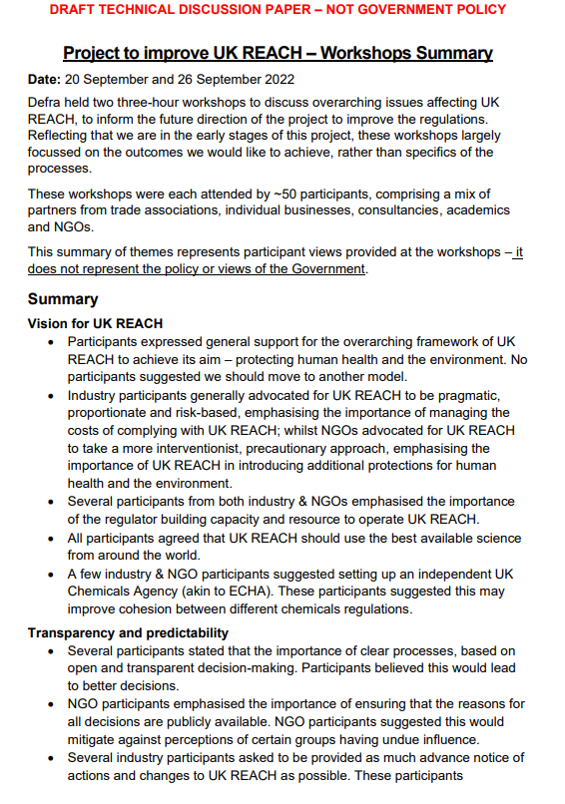
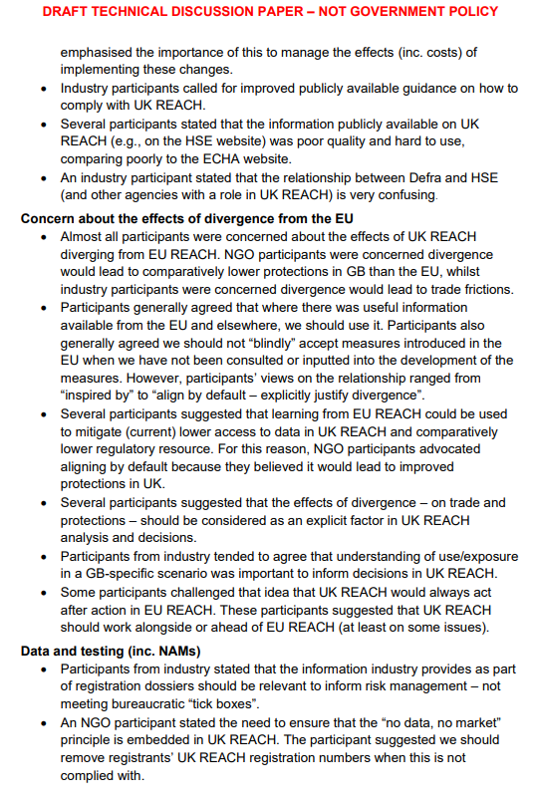
Information supplied by Marlen Moreno
The power of membership www.sea.org.uk

Slide 25
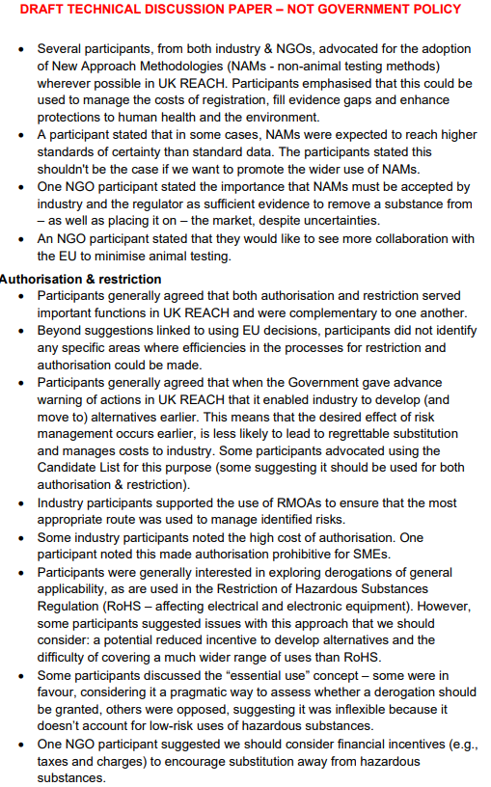
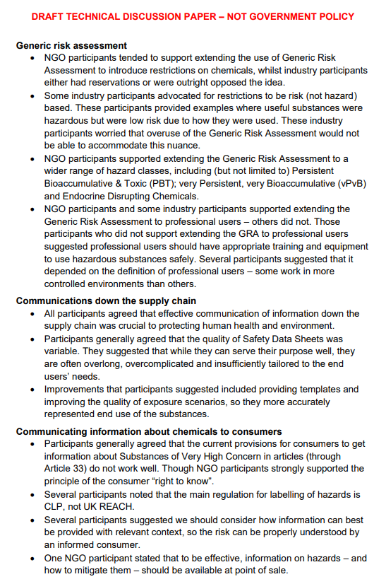
Information supplied by Marlen Moreno
The power of membership www.sea.org.uk

Slide 26

DONM – 2023 dates to be confirmed
The power of membership www.sea.org.uk

